Slide 1
Matched-field source localization using sparsely-coded neural network and data-model mixed training
Shougui Cai, Wen Xu
College of Information Science & Electronic Engineering
WUWNet’17 November 8, 2017, Halifax , Canada

Slide 2
MFP and SSP mismatch problem
Source localization is a basic problem in underwater acoustics
matched-field processing (MFP) is one of the mostly-studied;
sensitive to the mismatch problem;
Machine learning methods learn directly from the observation
do not require a good a prior information;
can be designed to implement a required processing;
be able to work at different scenarios by well trained;
View source localization as a machine learning problem
easy to establish a probability distribution model by neural networks;
also, capable of representing almost any data distribution;
convenient for us to train the model by using modern machine learning frameworks.

Slide 3
Contents
Neural network based source localization prediction model
Performance comparison with two MFP methods
Model robustness on SSP mismatch
Data-model mixed training
Summary & Future work

Slide 4
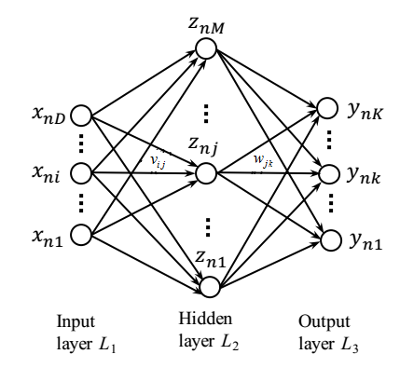
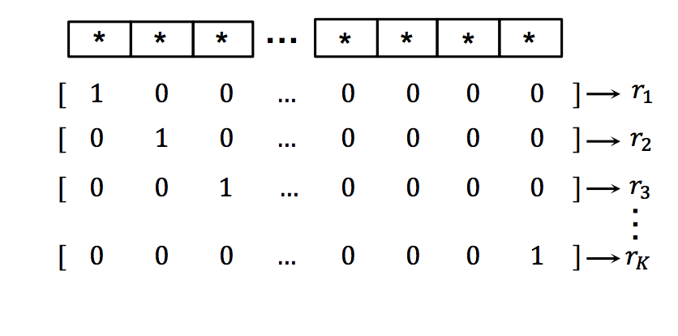
Neural network based source localization
Input: Sample cov. Matrix: 441 Neurons (21*22/2*2-21) per frequency
Output: binary range vector: 1.1475-8.6475 km, 300 neurons, 25m each
Just one middle layer, 500 Neurons
[1] Niu, H., and Gerstoft, P. Source localization in an ocean waveguide using supervised
machine learning. JASA (2017), 1176–1188.

Slide 5
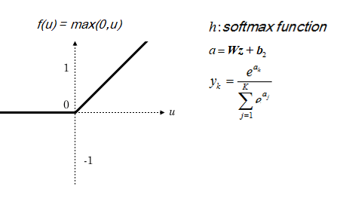
Neural network based source localization
FNN with one hidden layer
(a)
(b)

Slide 6
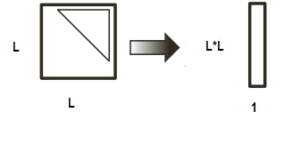
Neural network based source localization
Input data preprocessing
Sound pressure:
Normalized:
Sample covariance matrices:
Concatenate upper triangular elements’ real and imaginary parts, vectorize to create input x

Slide 7
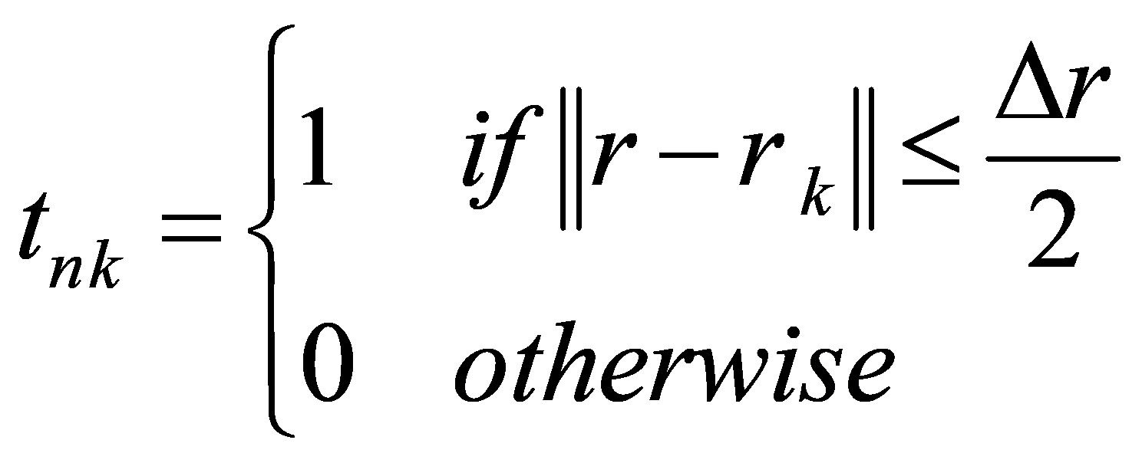
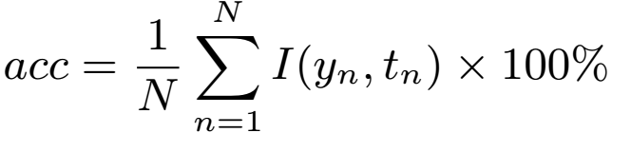
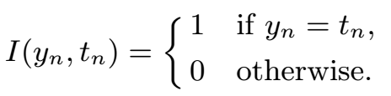
Neural network based source localization
Source range mapping
Mapping rang into K bins of width with
Training criterion
negative log-likelihood & sparsity constraint on FNN
Definition of model accuracy

Slide 8
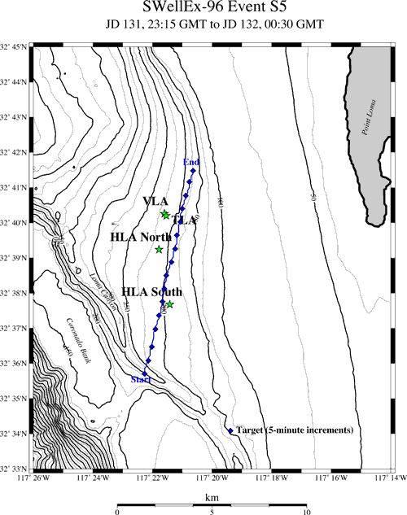
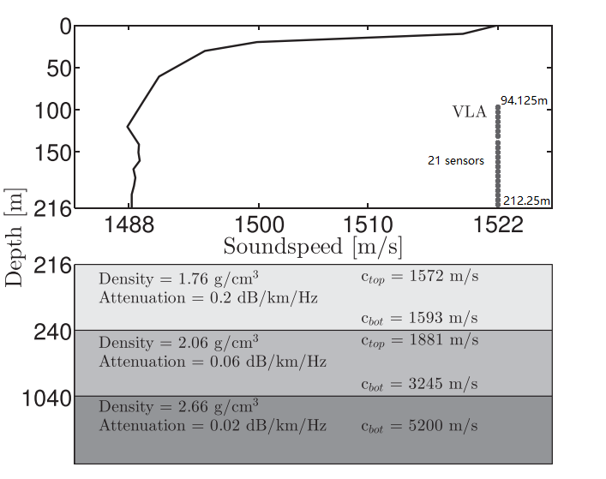
SWellEx96 Event S5
Environmental model and source-receiver configuration
Shallow source: depth 9m;
Frequency: 109, 232, 385Hz used;
(a)
(b)

Slide 9
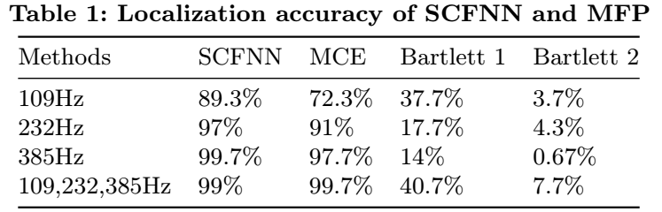
Performance comparison with MFP
SWell96Ex-S5 experimental data
Accuracy: SCFNN > MCE > Bartlett1 > Bartlett2
Note: There are two kinds of replica-field used.
Bartlett 1 measurement data; Bartlett 2, simulated by model.

Slide 10
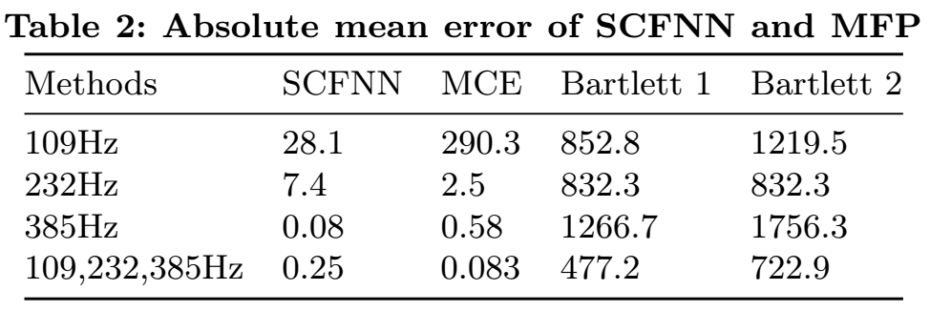
Performance comparison with MFP
SWell96Ex-S5 experimental data
Error: SCFNN < MCE < Bartlett1 < Bartlett2
Note: There are two kinds of replica-field used.
Bartlett 1 measurement data; Bartlett 2, simulated by model.

Slide 11
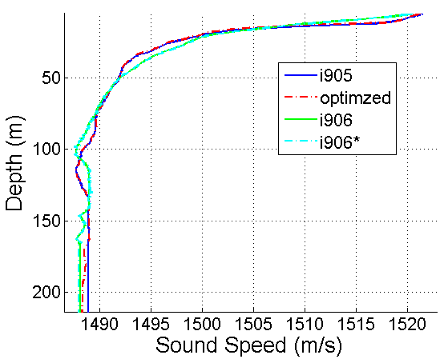
Model robustness on SSP mismatch
Diﬀerent degrees of error in the knowledge of SSP
Compared to the optimized,
i906, significant change in shape ;
i905, change is slight;
i906*, changed from i906, for the sake of testing.
optimized one is the best SSP model for real environment of SWellEx-96 experiment,
while,i906, i905 are the measured SSPs from diﬀerent stations.

Slide 12
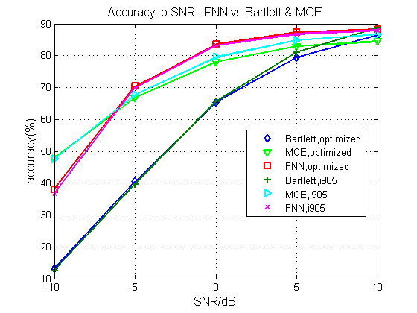
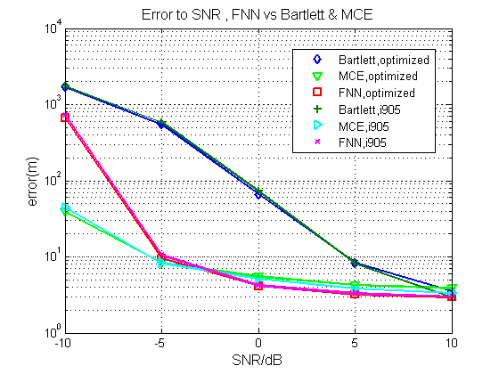
Model robustness on SSP mismatch
Monte-Carlo Simulation (1000 times)
Case 1: light change in SSP
SCFNN positions best, followed by MCE and Bartlett worst;
Notes:
In the MFP method, the model accuracy is heavily aﬀected by the mismatch problem
The performance curves for SCFNN, Bartlett and MCE vs SNR are plotted by 1000 times Monte Carlo simulations is plotted here.
The snapshot number here is 10.
legend ‘FNN,i905’ means that, the corresponding method is FNN and the test data is from i905 environment, rests are similar.

Slide 13
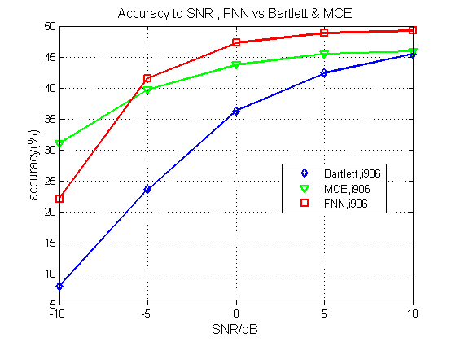
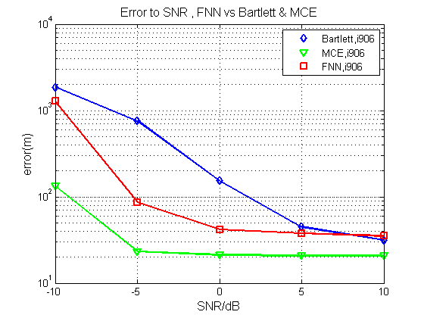
Model robustness on SSP mismatch
Monte-Carlo Simulation (1000 times)
Case 2: large change in SSP
accuracy order unchanged;
absolute mean error, SCFNN larger than MCE.
Notes:
the SCFNN is also sensitive to SSP mismatch. When the environment SSP has a big change in shape, the classifier trained by single data set performs poorly.
for example, the model, trained by data set corresponding to ssp-optimized , performs poorly on ssp-i906*,
and the accuracy drops about 40%, compared with the performance on ssp-i905.
3. although, SCFNN is also sensitive to SSP mismatch, still performs better than Bartlett and the performance of SCFNN is close to the MCE method.

Slide 14
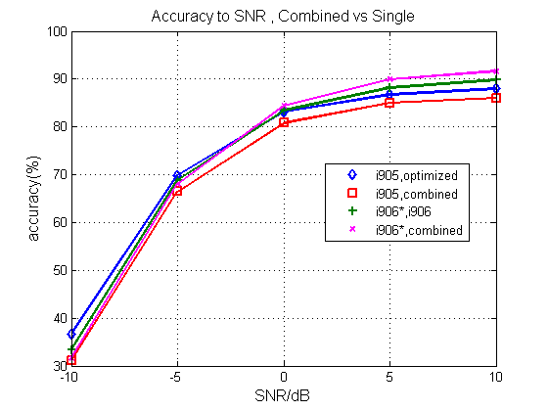
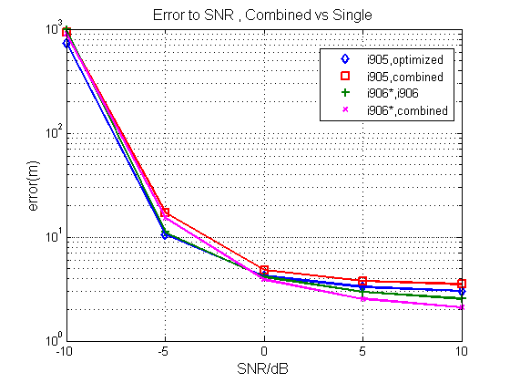
Data-model mixed training
Monte-Carlo Simulation (1000 times)
Model robustness is significantly improved
Notes:
1. by combining the data collected from ssp-i906 and ssp-optimized as training set,
the robustness of the classifier increases significantly; as the fig. shows,
2. the re-trained classifier predicts accurately on ssp-i906*, just as well as on ssp-i905.
3. Although the accuracy for i905 has a little glissade compared with data training only case, the performance for i906 is improved.
4. By mixed data-model training, the SCFNN classifier works well on two entirely diﬀerent SSPs.
5. the legend ‘i905,combined’ means the model is trained by mixed data, and then tested on ssp-i905.

Slide 15
Summary
SCFNN works well in localization problem
perform better than Bartlett, MCE methods;
and is also sensitive to SSP mismatch
varying on diﬀerent degrees of error in the knowledge of SSP;
still performs better than Bartlett and close to the MCE method;
model robustness can be improved by data-model mixed training
SCFNN classifier can work well on two entirely diﬀerent SSPs;
performance may be improved by add some ‘noise’ data;
also, neural network based model behaves poorly in low SNR case.
Notes:
1. we propose a method that can help reduce the mismatch problem in matched-field source localization,
by using a sparsely-coded feed-forward neural network(SCFNN), combined with data-model mixed training.
2. The proposal is examined on SWellEx-96 experiment.
To be specific, we firstly train and test a prediction model on the experimental data, and confirm that the SCFNN works well on source localization.
Then, the inﬂuence of SSP mismatch on the SCFNN classifier is investigated by simulations.
Finally, we train the SCFNN with mixed environment model data. It can be seen that the model robustness is significantly improved and the trained classifier performs well on varying SSP environments.
3. The discussions on applying machine learning methods to overcome mismatch problem in underwater source localization are preliminary and only a fine-tuned FNN is used.
Machine learning has potential advantages in unstable underwater acoustic environment and thus deserves more further eﬀorts.

Slide 16
Future work
Feature enhancement & adversarial learning on noise;
Mathematical analysis & explain robustness on mixed training.
Notes:
I believe that carefully implemented machine learning techniques can have in helping to characterize and to better understand natural systems and the physical mechanisms that drive them
We plan to train a sparse representation model. The learned feature space spans data (SCM) space likelihood that few basis functions. Try to explain how the SCFNN works and how does the model robustness improved?
By now, In our example, the input 1323-elements SCM data space can be spanned by the 740 feature vectors, and averagely, each data sample can be represented by only 16 features.

Slide 17
Thank you for listening!

Slide 18
Matched-field source localization using sparsely-coded neural network and data-model mixed training
Shougui Cai, Wen Xu
College of Information Science & Electronic Engineering
WUWNet’17 November 8, 2017, Halifax , Canada

